Slide 1
DDOS prevention Cloudflare

Slide 2
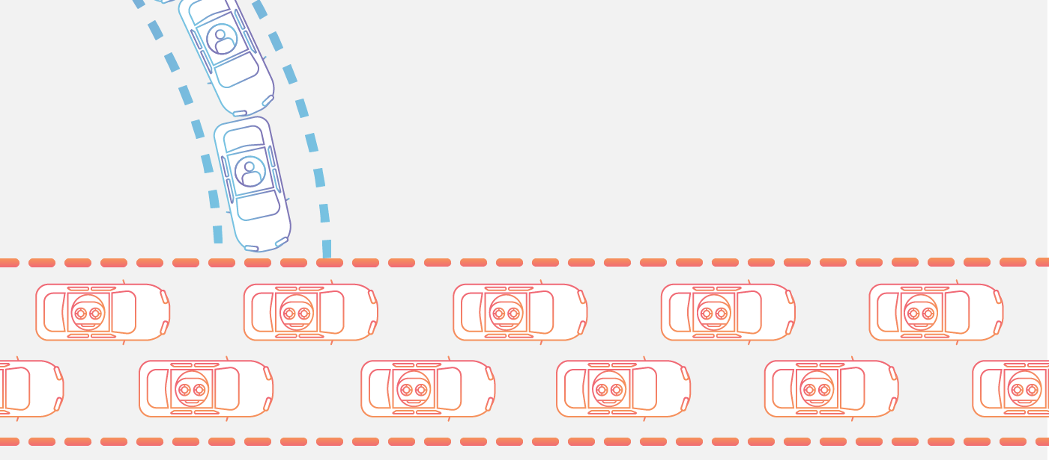
What is a DDoS attack?
A distributed denial-of-service (DDoS) attack is a malicious attempt to disrupt the normal traffic of a targeted server, service or network by overwhelming the target or its surrounding infrastructure with a flood of Internet traffic.

Slide 3
How does a DDoS attack work?
DDoS attacks are carried out with networks of Internet-connected machines.
These networks consist of computers and other devices (such as IoT devices)which have been infected with malware, allowing them to be controlled remotely by an attacker. These individual devices are referred to as bots (or zombies), and a group of bots is called a botnet.
Once a botnet has been established, the attacker is able to direct an attack by sending remote instructions to each bot.
When a victim’s server or network is targeted by the botnet, each bot sends requests to the target’s IP address, potentially causing the server or network to become overwhelmed, resulting in a denial-of-service to normal traffic.
Because each bot is a legitimate Internet device, separating the attack traffic from normal traffic can be difficult.

Slide 4
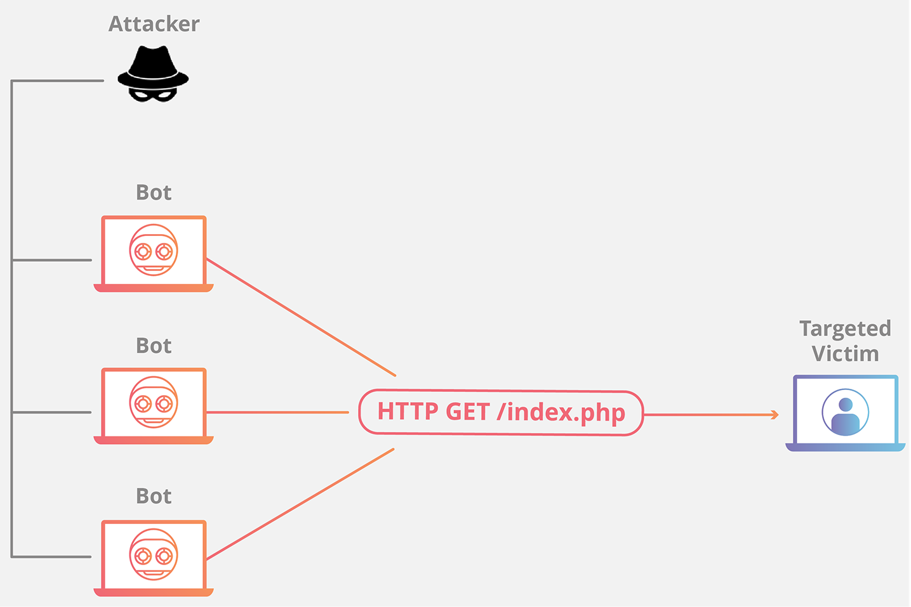

Slide 5
How to identify a DDoS attack
The most obvious symptom of a DDoS attack is a site or service suddenly becoming slow or unavailable. But since a number of causes — such a legitimate spike in traffic — can create similar performance issues, further investigation is usually required. Traffic analytics tools can help you spot some of these telltale signs of a DDoS attack:
Suspicious amounts of traffic originating from a single IP address or IP range
A flood of traffic from users who share a single behavioral profile, such as device type, geolocation, or web browser version
An unexplained surge in requests to a single page or endpoint
Odd traffic patterns such as spikes at odd hours of the day or patterns that appear to be unnatural (e.g. a spike every 10 minutes)

Slide 6
About Cloudflare DDoS Protection
Cloudflare provides unmetered and unlimited distributed denial-of-service (DDoS)Open external link protection to all customers on all plans and services.
The protection is enabled by Cloudflare’s Autonomous DDoS Protection Edge, which automatically detects and mitigates DDoS attacks.
The Autonomous Edge includes multiple dynamic mitigation rules exposed as Cloudflare DDoS Attack Protection Managed Rulesets, which provide comprehensive protection against a variety of DDoS attacks across L3/4 and L7 of the OSI model.

Slide 7
How it works
To detect and mitigate DDoS attacks, Cloudflare’s Autonomous Edge and centralized DDoS systems analyze traffic samples “out-of-path”, which allows Cloudflare to asynchronously detect DDoS attacks without causing latency or impacting performance.
The analyzed samples include:
Packet fields such as the source IP, source port, destination IP, destination port, protocol, TCP flags, sequence number, options, and packet rate.
HTTP request metadata such as HTTP headers, user agent, query-string, path, host, HTTP method, HTTP version, TLS cipher version, and request rate.
HTTP response metrics such as error codes returned by customers’ origin servers and their rates.

Slide 8
Once attack traffic matches a rule, Cloudflare’s systems will track that traffic and generate a real-time signature to surgically match against the attack pattern and mitigate the attack without impacting legitimate traffic. The rules are able to generate different signatures based on various properties of the attacks and the signal strength of each attribute. For example, if the attack is distributed — that is, originating from many source IPs — then the source IP field will not serve as a strong indicator, and the rule will not choose the source IP field as part of the attack signature. Once generated, the fingerprint is propagated as a mitigation rule to the most optimal location in the Cloudflare edge for cost-efficient mitigation. These mitigation rules are ephemeral and will expire shortly after the attack has ended, which happens when no additional traffic has been matched to the rule.

Slide 9
References:
https://www.cloudflare.com/learning/ddos/what-is-a-ddos-attack/
https://developers.cloudflare.com/ddos-protection/about/

